Slide 1

WIND PANEL
PRESENTED BY: TEAM MEMBERS:
GROUP 6, IPBA 6A Gangesh Singhal
Md. Sahjad Farouqui
Prashant Ojha
Rishika Maheshwari
Saif Mohammad
Animesh Parikshya
Dr. Anshika Sharma

Slide 2
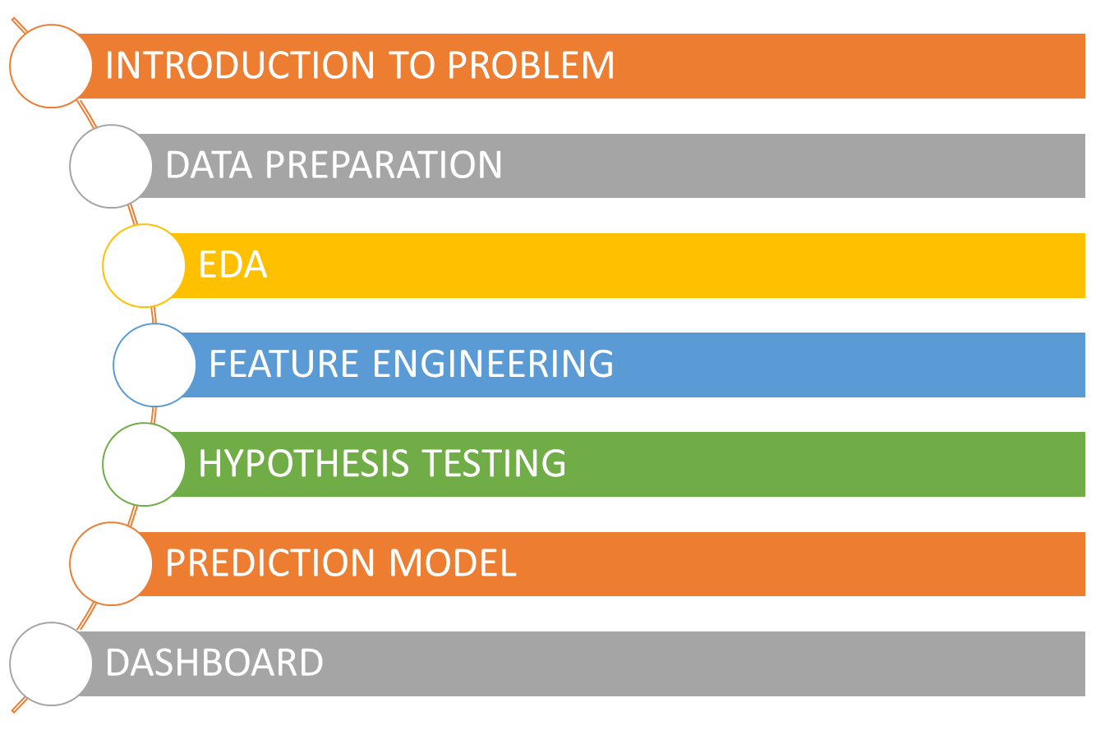
CONTENTS

Slide 3


Slide 4
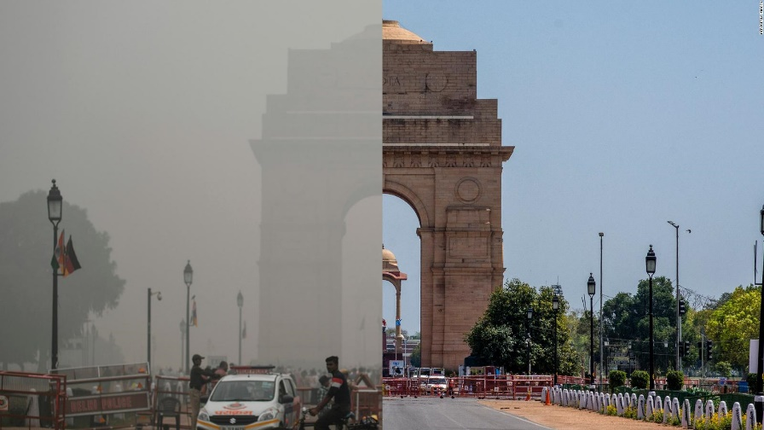
GENESIS
Air Pollution causes significant reduction of lung capacities and increase of heart attacks, forcing people to live compromised lives and lifestyle.
Economic Loss:
10.7 Lakh Crore
Work Absence:
49 Crore Days/year
GDP Loss:
5.4 % of total GDP Annually
Premature Deaths:
12.5 Lakh Annually
Pollution:
22 out of 30 world’s most polluted cities in India
Diseases :
Cardiovascular, Respiratory, cancer, pre-term births
Center for Research on Energy and Clean Air https://energyandcleanair.org/publications/costs-of-air-pollution-from-fossil-fuels/
WorldBank.Org https://blogs.worldbank.org/endpovertyinsouthasia/indias-air-pollution-woes

Slide 5
PROBLEM STATEMENT
Our product aims at revolutionizing the lifestyle of the people into a much healthier one, however, the main issue crops in as it is impossible to trace cleaner air and its aftereffects from a vast infinite volume of space. Our devices would work consistently and efficiently but can’t be bifurcated from the overall data of air quality index which is being captured by the monitoring stations of Central Pollution Control Boards (CPCB).

Slide 6
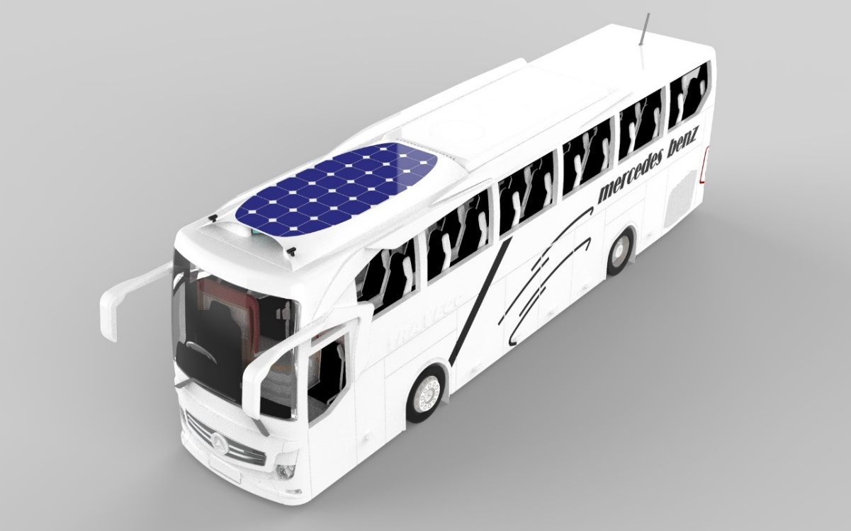
WIND PANEL
A Vehicle rooftop innovative device – “Wind Panel”
Purifies Air and Produce Renewable energy
Polluted air passes through device when vehicle is moving
Filtration system purifies it
Deliver clean air
Produce Renewable Energy through Wind and Solar
Inlet Air – Particulate Matter, Dust, CO, SO₂ , NO_{x}
Outlet Air – Clean Air

Slide 7
BUSINESS OBJECTIVES
Find how many devices would be required within the Delhi/NCR region to bring down the average PM concentration level by 25% in the next 5 years.
Find which areas in the Delhi/NCR region are the most polluted, thus specifically targeting those DTC bus routes for pilot project.
Form a mathematical/statistical relation between the Area of the city, average AQI levels, and the no. of devices needed.
Calculate approximately how much Carbon content will be collected on the Electrostatic Precipitator.
Calculate approximately how much Particulate Matter and dusts will be collected on the Air Filters.
Find which other Indian states would be the best market for expansion.

Slide 8
DATASET PREPARATION

Slide 9
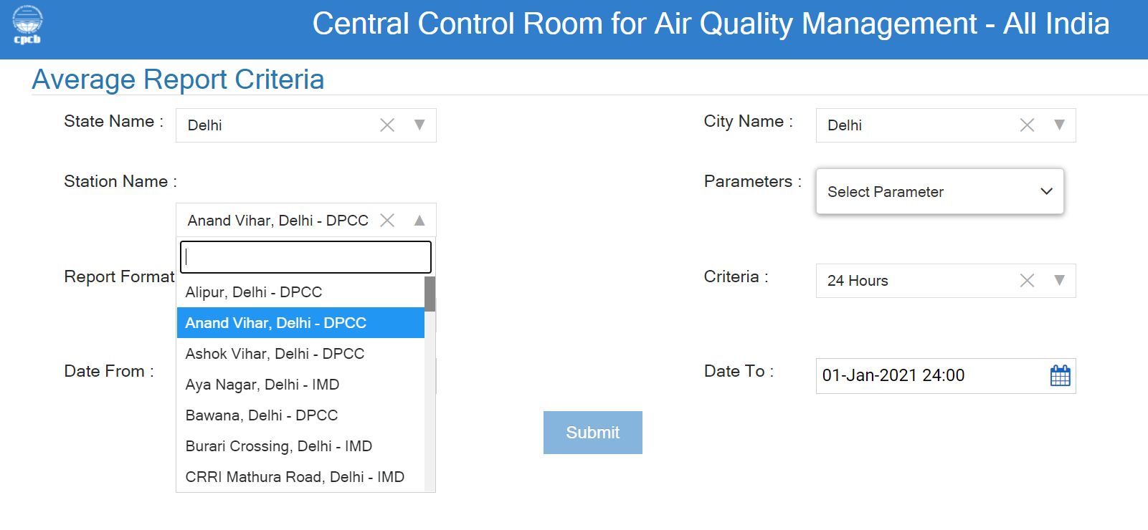
DATA COLLECTION
Manually downloaded data for all 40 monitoring stations from Jan 2016 – Apr 2021
Considering 5 parameters for study – PM10, PM 2.5, NOx, SO2 & CO.

Slide 10
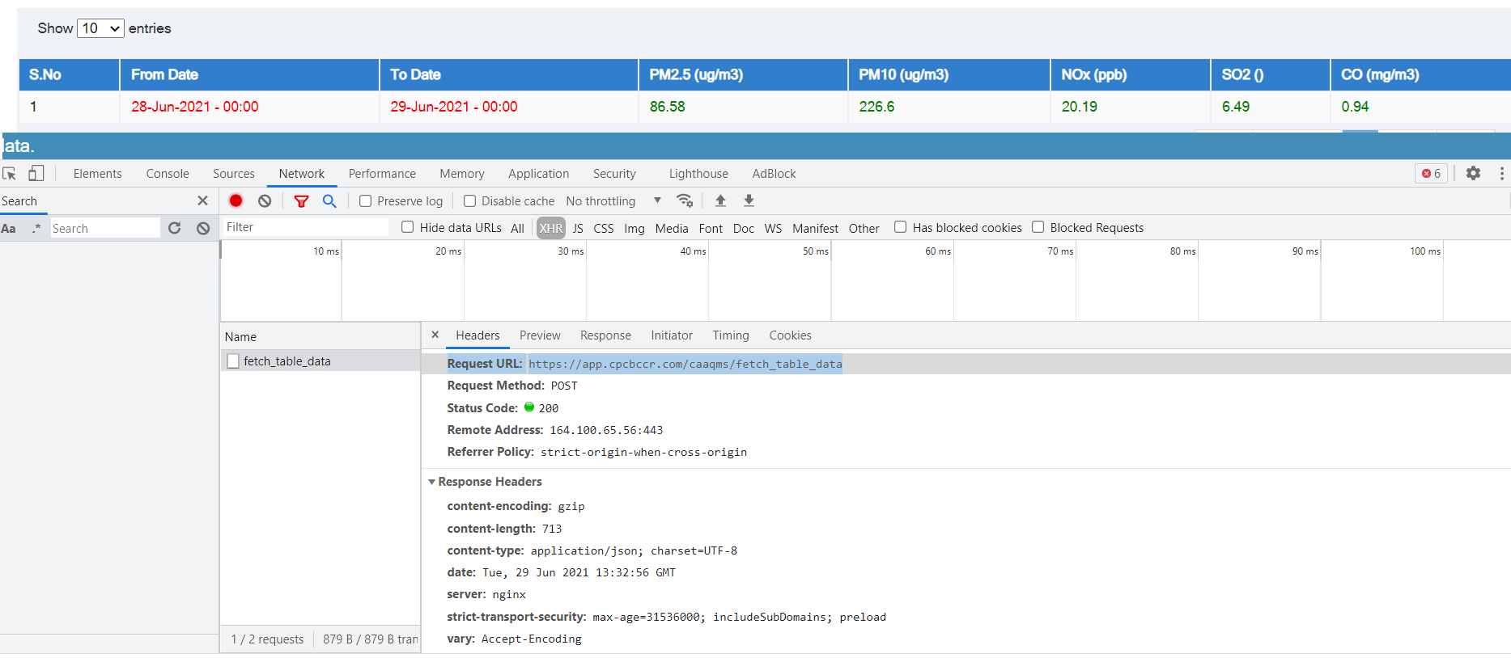
WEB SCRAPPING
Developed a Web Scrapping Code in SQLITE
Fetch The data by hitting the API: https://app.cpcbccr.com/caaqms/fetch_table_data
Request on basis of Dates
Request on basis of Pollutants unique code
Snippet of the connection
db= dataset.connect('sqlite:///../data/db/data.sqlite3')

Slide 11
MISSING VALUE TREATMENT
MEAN
GEO SPATIAL
ARIMA
CASE1 : When less than 3 consecutive values missing.
Taking average of 5 days before and after.
CASE2 : When starting values are missing.
Using Geo-pandas to fill values from nearby stations.
CASE3 : When more than 3 consecutive values missing.
Predicting values from previous dates.

Slide 12
OUTLIER TREATMENT
Interpretation:
After analyzing Boxplots of every pollutant for each station, only two of the boxplot have unacceptable outliers as mentioned below:
PM2.5 Pollutant for Ashok Vihar (filtering all the values which have more than 1000 value).
SO2 Pollutant for Punjabi Bagh (most realistic value are below 150, therefore, filtering anything above it).

Slide 13
EXPLORATORY DATA ANALYSIS

Slide 14
POLLUTANTS DISTRIBUTIONS
Interpretation:
The area chart shows that how the concentration level of pollutants are stacked across all the stations of Delhi.
Highest concentration level results for PM10 and PM 2.5.

Slide 15
STATIONWISE POLLUTANTS CONCENTRATION LEVEL OF PM2.5 & PM10
Interpretation:
The concentration level of PM2.5 is highest in Jahangirpuri and lowest in Dr. Karni Singh Shooting Range.
In reference to PM10, the concentration level is maximum in Dwarka-Sector 8, and minimum in Sri Aurobindo Marg.

Slide 16
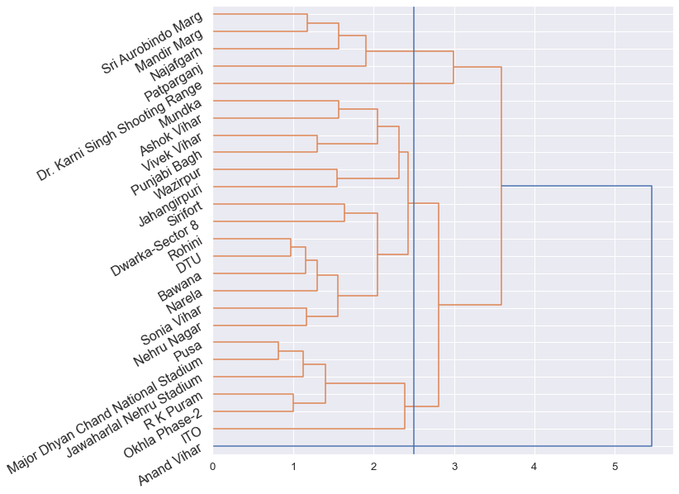
DENDOGRAM
Interpretation:
By considering all pollutants, the most polluted stations are found to be Anand Vihar, Jahangirpuri, Narela and Patparganj.

Slide 17
FEATURE ENGINEERING

Slide 18
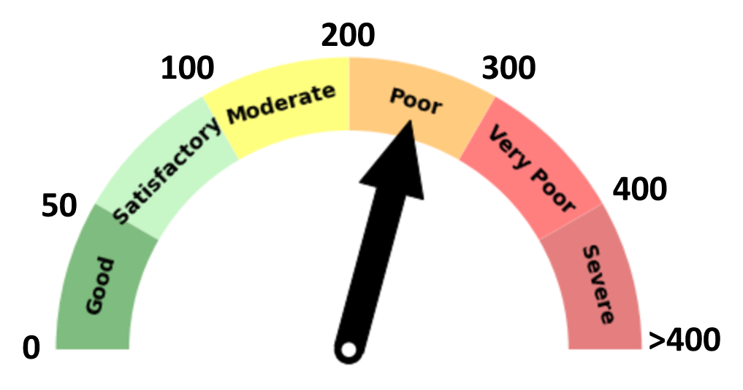
AQI CALCULATION
Interpretation:
Calculating Sub-Index and AQI
Categorically dividing into 5 categories – Good, Moderate, Poor, Very Poor, Hazardous.
AQI results for all stations lies in the range of 200-300 i.e., belongs to poor category

Slide 19
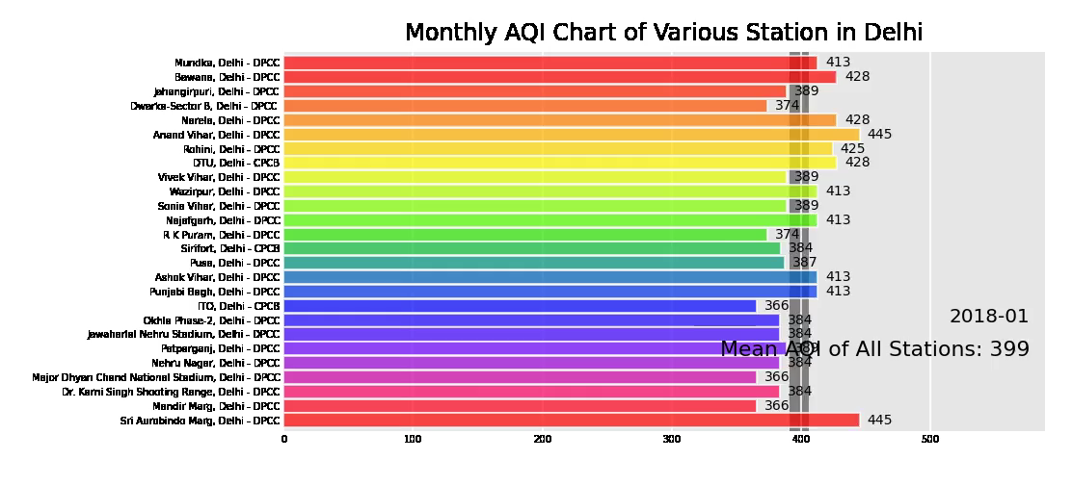
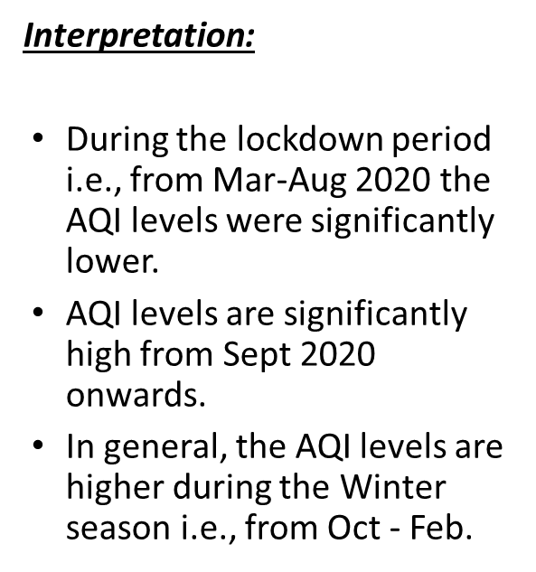
MONTHLY MEAN AQI CALCULATION USING RACING BAR CHART

Slide 20
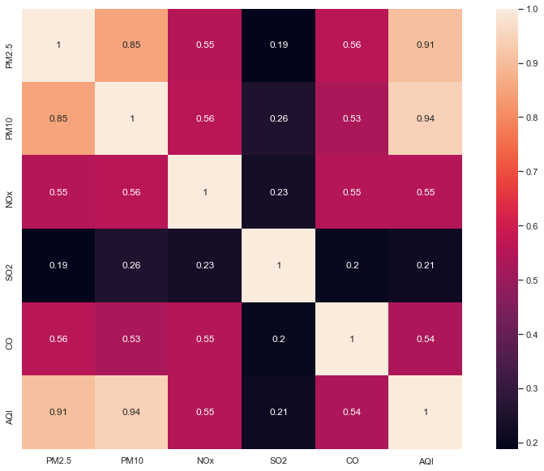
CORRELATION BETWEEN POLLUTANTS AND AQI
Interpretation:
From the correlation matrix, AQI w.r.t. PM2.5 and PM10 shows high correlation value. It is also followed that PM2.5 w.r.t. PM10 are too having high correlation with each other else there is little correlation between other pollutants.

Slide 21
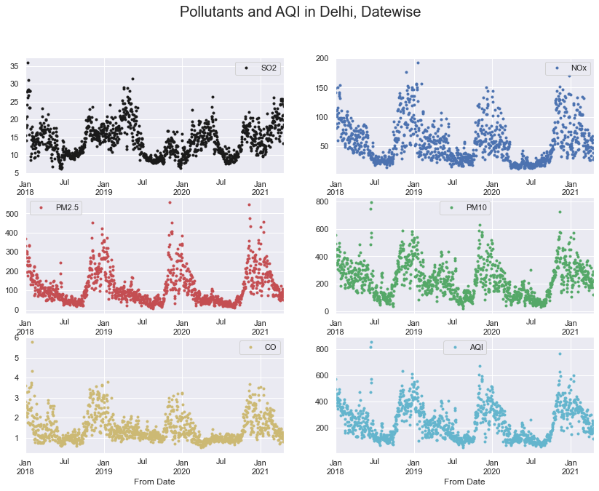
SEASONALITY CHECK
Interpretation:
All the five pollutants changes seasonally.
The concentration rate of all the pollutants including AQI is seen high during winter season. The reason could be high air density during winter season, Diwali festival, Marriages, more travelling due to vacations etc. which are beyond human control.

Slide 22
HYPOTHESIS TESTING

Slide 23
HYPOTHESIS 1
There is a reduction in concentration levels after installing a Smog Tower in Lajpat Nagar, Delhi on 2 Jan 2020 onwards
Ho - There is no reduction in AQI concentration levels
H1 - There is a reduction in AQI concentration levels
Interpretation:
Z-Test (Test Statistic): 5.40968425
p-value: 6.31359636e-08
Since the p-value is much smaller than 0.05 therefore, there is much evidence to reject the Null Hypothesis. Hence, there is a reduction in AQI concentration levels after installing Smog Tower.

Slide 24
HYPOTHESIS 2
Odd-Even scheme (Nov 4 - Nov 15, 2019 ) implemented in Delhi resulted in reduction of 30% vehicle density. How much is the vehicle density related to AQI levels of the city.
H0 - Vehicle density does not depend on AQI
H1 - Reduction in vehicle density results in lower AQI levels
Interpretation:
T-Test (Test Statistic): 0.44964425
p-value: 0.65736586
Since the p-value is greater than 0.05 , therefore, there is much evidence to failed to reject Null Hypothesis. Hence, vehicle density is not having any impact on AQI levels.

Slide 25
PREDICTION MODEL

Slide 26
PM10 FORECASTING
Interpretation:
The forecasted results using Holt Winter Exponential Smoothening gave less MSE values as compared to ARIMA Model.
Seasonality in actual values and the forecasted values

Slide 27
REDUCTION IN PM 10 VALUES WITH AND WITHOUT DEVICES
Interpretation:
20% reduction with 50,000 devices.
Calculation:
Total PM 10 Collected over Air Filters = No. of devices * Total Amount Collected 1 Device
= 15,000 kg

Slide 28
DASHBOARD
C:\Users\anshi\Downloads\AQI Study Dashboard.twbx

Slide 29
REFERENCES
Beig et al. (2020). Towards baseline air pollution under COVID-19: implication for chronic health and policy research for Delhi, India. Current science.
Beig et al. (2019). Objective evaluation of stubble emission of North India and quantifying its impact on air quality of Delhi. Science of The Total Environment. 709. 136126. 10.1016/j.scitotenv.2019.136126.
Sachit Bandhu, S.S. (2020). Air Quality Index Prediction. International Research Journal of Engineering and Technology (IRJET), 2694-2698.
Srivastava C., Singh S., Singh A.P. (2018). Estimation of Air Pollution in Delhi Using Machine Learning Techniques. 2018 International Conference on Computing, Power and Communication Technologies (GUCON) Galgotias University, Greater Noida, UP, India. Sep 28-29.
https://otexts.com/fpp2/decomposition.html
https://machinelearningmastery.com/decompose-time-series-data-trend-seasonality/
https://thejeshgn.com/2020/02/14/

Slide 30
THANKS

Slide 31
Q n A

